Slide 1
Models of the motor system
Fall 2021
Opher Donchin

Slide 2
Part 1
Internal models

Slide 3
Internal models
Brain calculations of kinematics and dynamics

Slide 4
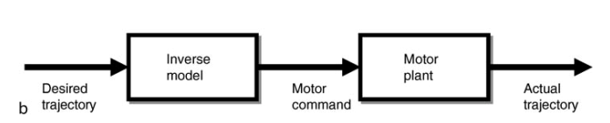
Inverse internal model
Invert the forward dynamics and kinematics
Cisek Encyclopedia of Neuroscience 2009 doi:10.1007/978-3-540-29678-2_2528

Slide 5
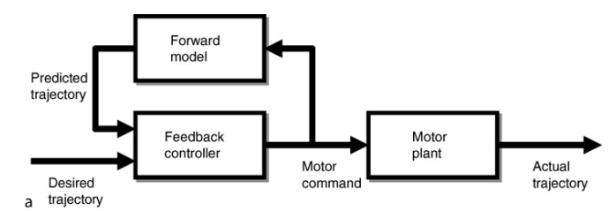
Forward internal model
Simulate the forward dynamics and kinematics
Cisek Encyclopedia of Neuroscience 2009 doi:10.1007/978-3-540-29678-2_2528

Slide 6
Part 2
Interaction torques

Slide 7
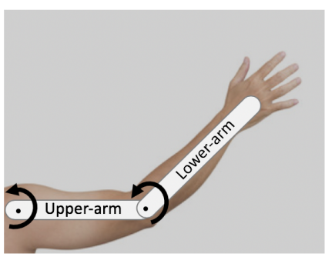
Intersegmental dynamics
Interaction moments
Torques at one joint due to motion of another joint

Slide 8
Coriolis effects across joints
If there are no torques
And only the shoulder is moving
And ignore gravity
The rotation of the shoulder acts like a torque opening the elbow

Slide 9
Coriolis effects across joints
If there are no torques
And only the elbow is moving
And ignore gravity
The rotation of the elbow acts like a torque closing the shoulder

Slide 10
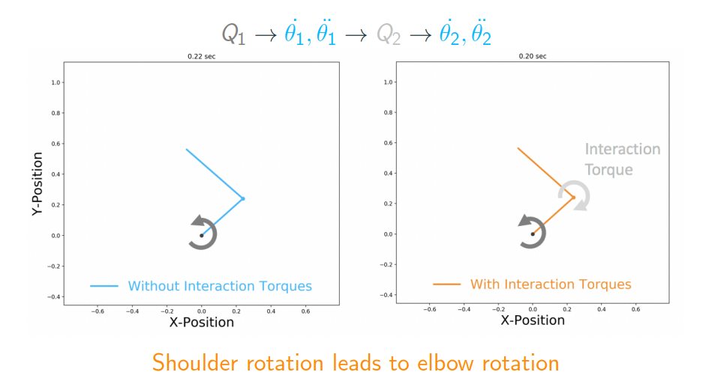
If elbow is passive
Shoulder flexion would cause elbow extension

Slide 11
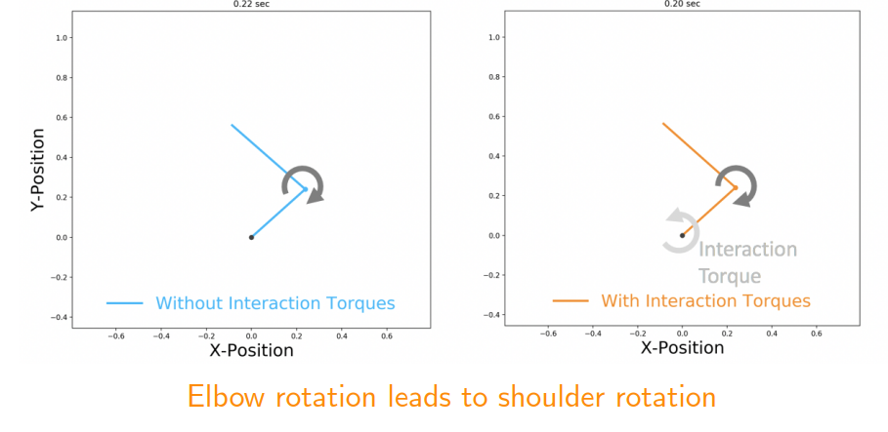
If shoulder is passive
Elbow flexion causes shoulder extension

Slide 12
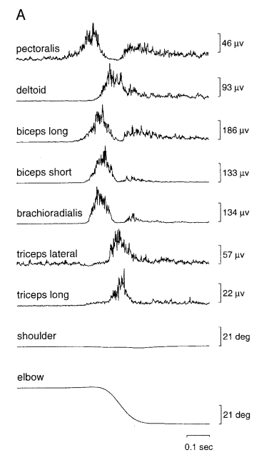
Motor system compensates for interaction torques
Single-joint elbow movement
Activation of shoulder muscles
No shoulder movement
Gribble J Neurophys 1999 doi:10.1152/jn.1999.82.5.2310

Slide 13
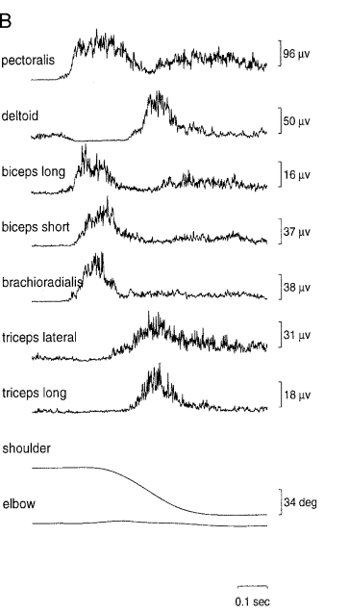
Motor system compensates for interaction torques
Single-joint shoulder movement
Activation of elbow muscles
No elbow movement
Gribble J Neurophys 1999 doi:10.1152/jn.1999.82.5.2310

Slide 14
Evidence of internal model
Pre-planning for interaction torques
Internal inverse model of dynamics

Slide 15
Part 3
Cerebellar ataxia

Slide 16
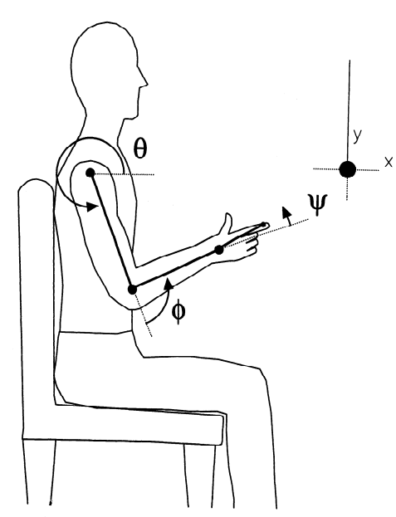
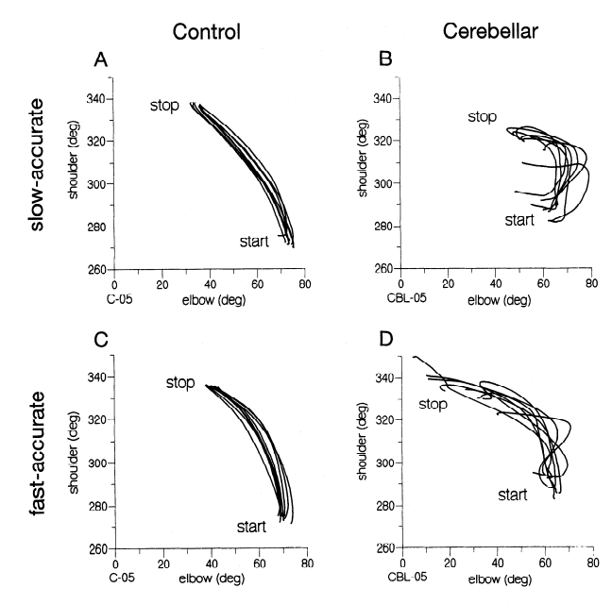
Cerebellar disorder
Ataxia
Disjoint movements
Lack of cooordination
Bastian J Neurophys 1996 doi:10.1152/jn.1996.76.1.492

Slide 17
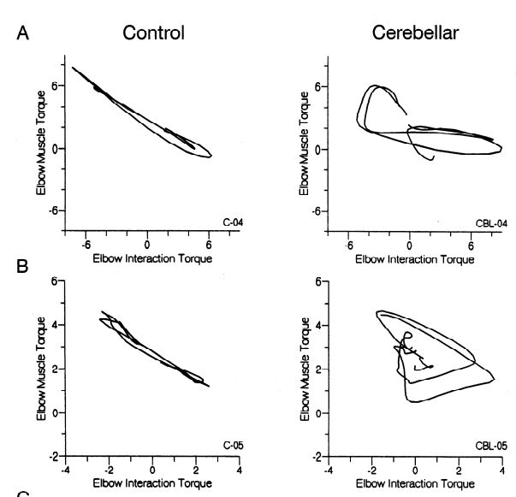
Ataxia reflects failure to compensate for interaction torques
Decompose forces on elbow
Muscle forces
Interaction forces
Cerebellar patients fail to compensate
Bastian J Neurophys 1996 doi:10.1152/jn.1996.76.1.492

Slide 18
Cerebellar ataxia
Caused by
Stroke
Trauma
Cellular degeneration (genetic)
Excessive alcohol
Symptoms
Intention tremor
Dysmetria
Slurred speech
Balance

Slide 19
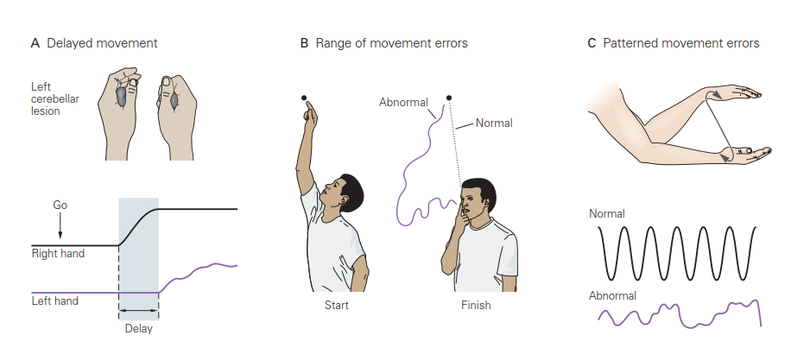
Cartoon version
Textbook figure

Slide 20
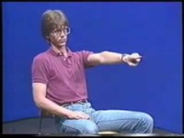
Demonstration of ataxia

Slide 21

Talking with a patient

Slide 22
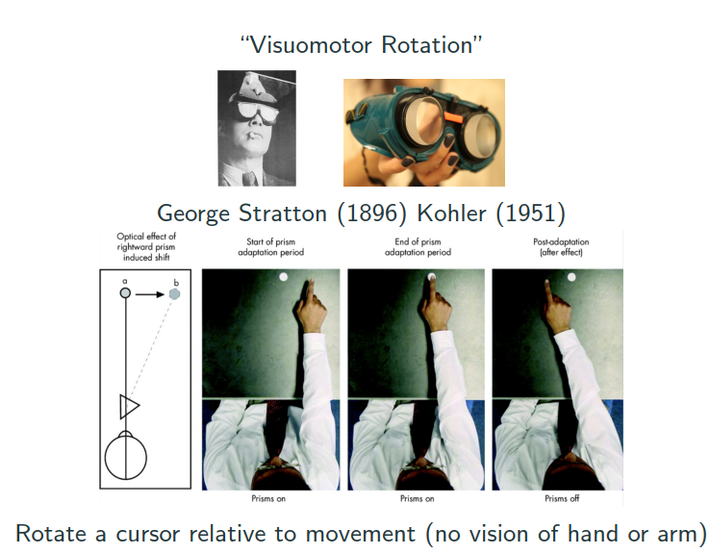
Prism adaptation

Slide 23
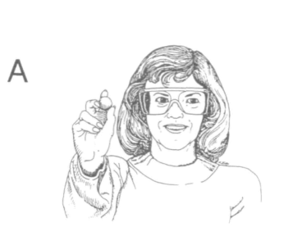
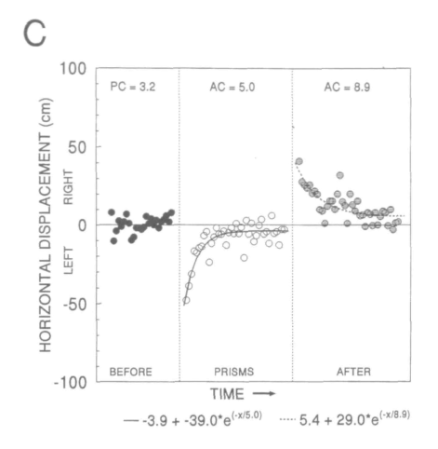
Normal learning in prism adaptation
Martin Brain 1996 doi:10.1093/brain/119.4.1183

Slide 24
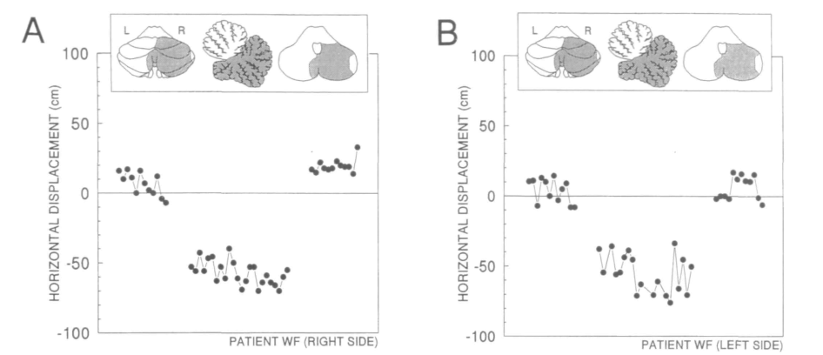
Impaired cerebellar learning
Martin Brain 1996 doi:10.1093/brain/119.4.1183

Slide 25
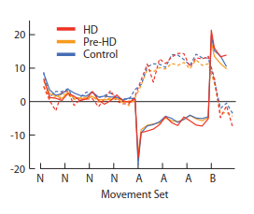
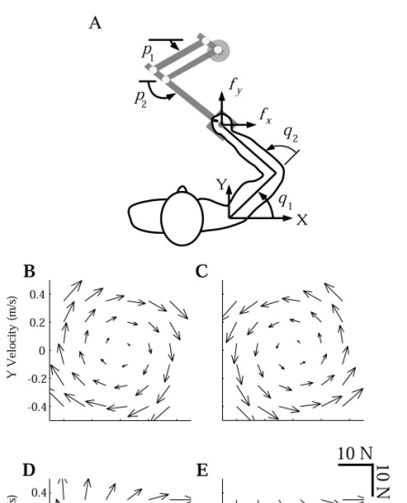
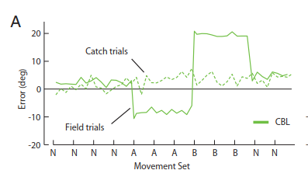
Force field adaptation
Smith J Neurophysiol 2004 doi:10.1152/jn.00943.2004

Slide 26
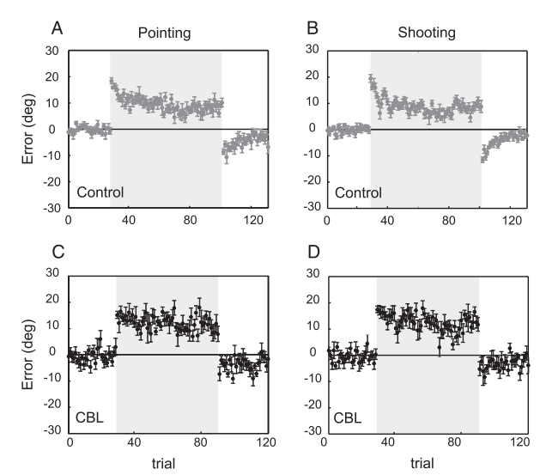
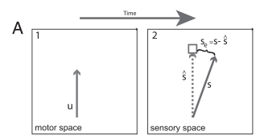
Visuomotor adaptation
Tseng J Neurophysiol 2007 doi:10.1152/jn.00266.2007

Slide 27
Other cerebellar dependent forms of adaptation
Saccade adaptation
Smooth pursuit adaptation
Locomotor adaptation
Split-belt treadmill adaptation

Slide 28
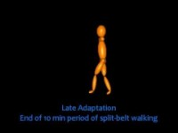
Split-belt treadmill

Slide 29
Part 4
Modelling adaptation

Slide 30
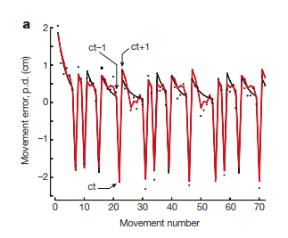
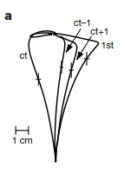
Trial-by-trial adaptation
Thoroughman Nature 2000 doi:10.1038/35037588

Slide 31
Model of adaptation

Slide 32
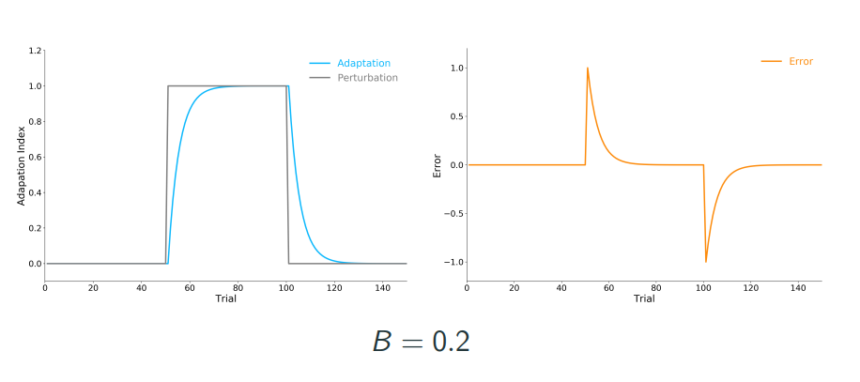
Simulating adaptation

Slide 33
Model fails to explain incomplete learning
Tseng J Neurophysiol 2007 doi:10.1152/jn.00266.2007

Slide 34
Better model of adaptation

Slide 35
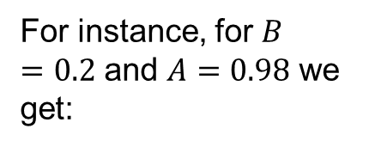
Steady state determined model
In steady state:
For instance, for $B=0.2$ and $A=0.98$ we get:

Slide 36
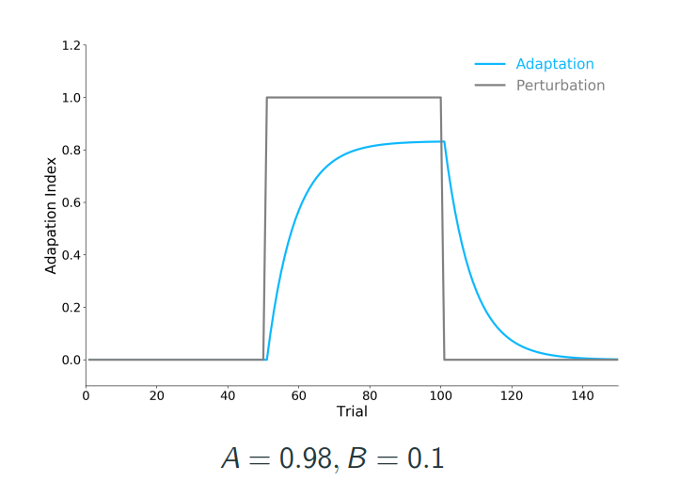
Model with forgetting

Slide 37

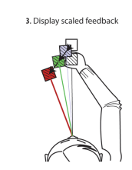
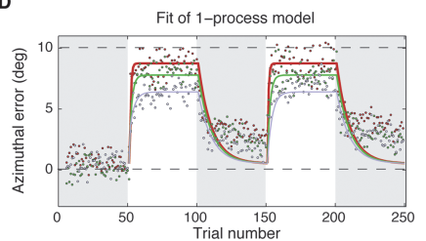
Increasing error magnitude effects learning but not forgetting
van der Kooij PLOS One 2015 doi:10.1371/journal.pone.0117901

Slide 38
Part 5
The cerebellum and the model

Slide 39
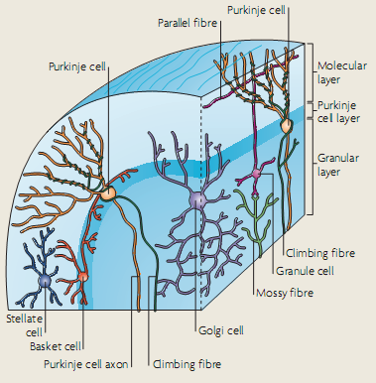
Cerebellar anatomy
Dean Nature Reviews Neuro 2010

Slide 40
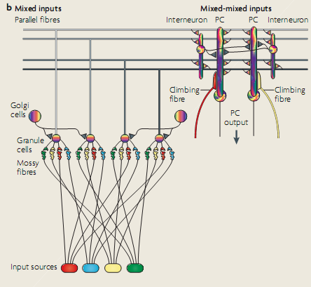
Schematic of input
Dean Nature Reviews Neuro 2010

Slide 41
The cerebellar model
Plasticity
Purkinje
Cells
Error
Efferent
copy
Plasticity
Deep
Cerebellar
Nuclei
Inferior
Olive
Pontine
nuclei
Feedback
Context
Motor output

